Slide 1
Chapter 10
Chapter 10
Broadband Network Management:
Access Networks
Network Management: Principles and Practice
© Mani Subramanian 2000
10-1

Slide 2
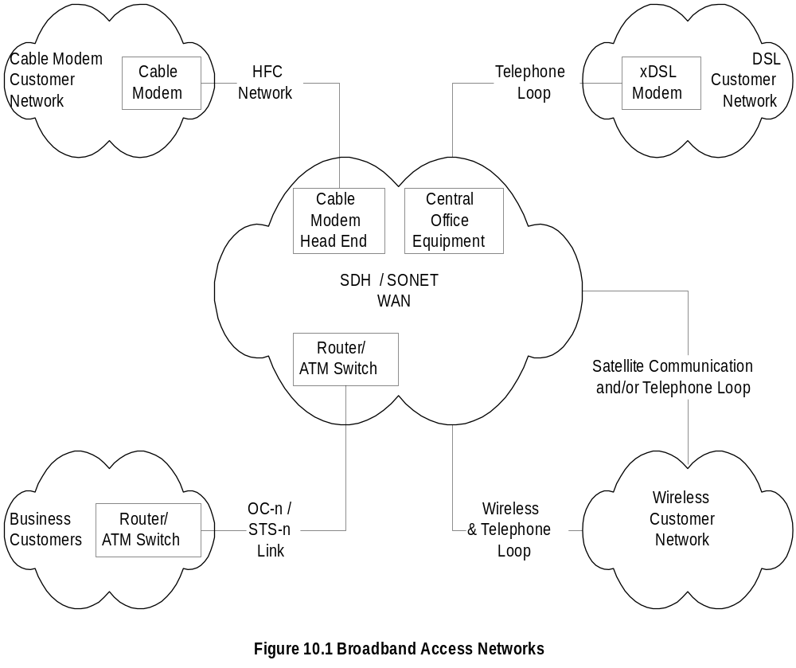
Chapter 10
Broadband Access Networks
  Notes
Three categories of customer base:
  Corporate or enterprise
  Service providers
  Residence or SOHO
Network Management: Principles and Practice
© Mani Subramanian 2000
10-2

Slide 3
Chapter 10
Broadband Access Networks
  Notes
Five types of access networks
  OC-n / STS-n link
  Gateway to service providers (not shown)
  HFC / Cable modem
  DSL
  Wireless
    Fixed wireless
    Satellite communication
Network Management: Principles and Practice
© Mani Subramanian 2000
10-3

Slide 4
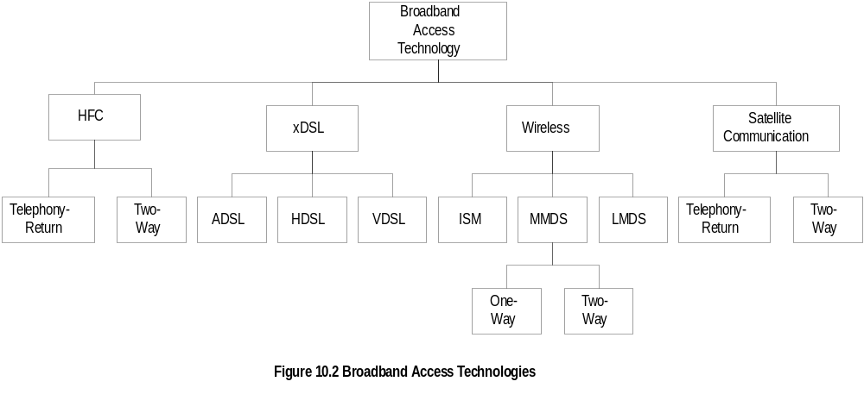
Chapter 10
Access Technologies
  Notes
Network Management: Principles and Practice
© Mani Subramanian 2000
10-4

Slide 5
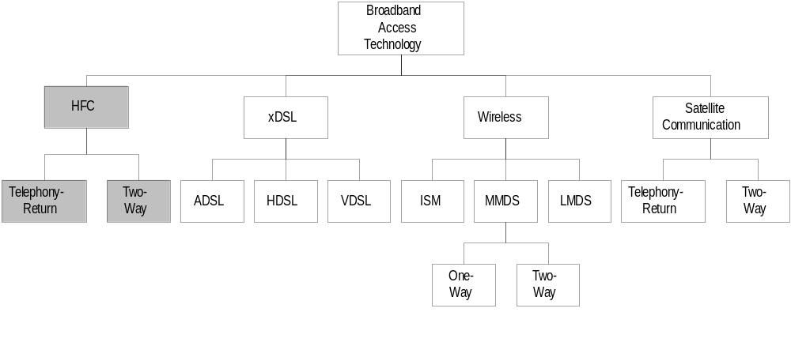
Chapter 10
Access Technologies
  Notes
Hybrid fiber coaxial technology plant / cable modem
at customer premises
  Telephony return is one-way, downstream
  (forward direction) cable, upstream (reverse
  direction) telephone
  Two-way downstream at high frequency band
  and upstream at low frequency band
Carries voice, video and data
Upstream bandwidth requirements less compared
to downstream bandwidth
Network Management: Principles and Practice
© Mani Subramanian 2000
10-5

Slide 6
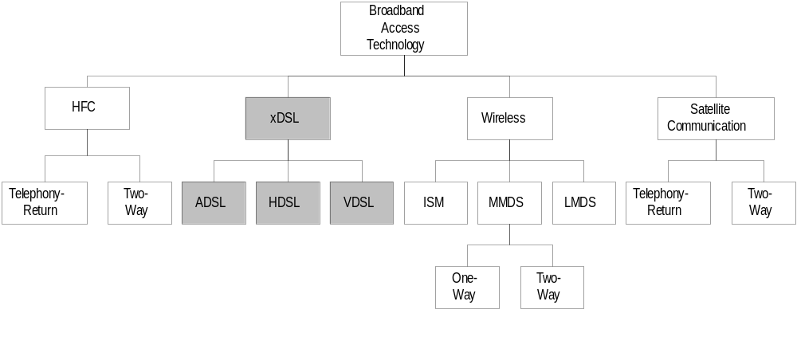
Chapter 10
Access Technologies
  Notes
xDSL: Digital subscriber line technology
  Asymmetric DSL (ADSL)
  High-speed DSL (HDSL)
  Very-high speed DSL (VDSL)
Uses existing local loop telephone facilities
Network Management: Principles and Practice
© Mani Subramanian 2000
10-6

Slide 7
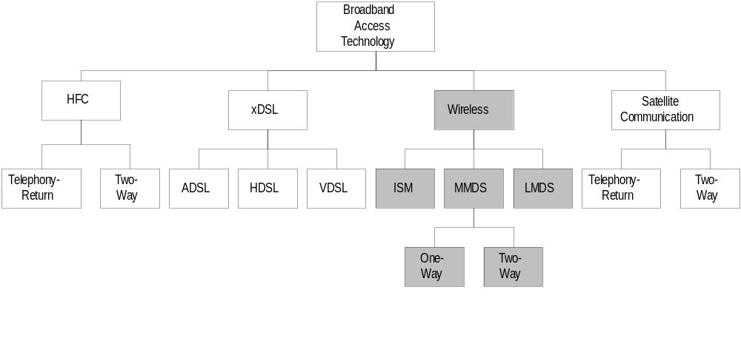
Chapter 10
Access Technologies
  Notes
Wireless: Terrestrial fixed wireless systems
  Instructional scientific and medical (ISM):
  902 - 928 MHz (0.5 mile) and
  2400 - 2483 MHz (15 miles)
  Multichannel multipoint distribution service
  (MMDS) 2500 - 2686 MHz (35 miles)
  Local multipoint distribution service
  27,500 - 28,350 MHz and 31,000 - 31,300 MHz
  (3 miles)
Network Management: Principles and Practice
© Mani Subramanian 2000
10-7

Slide 8
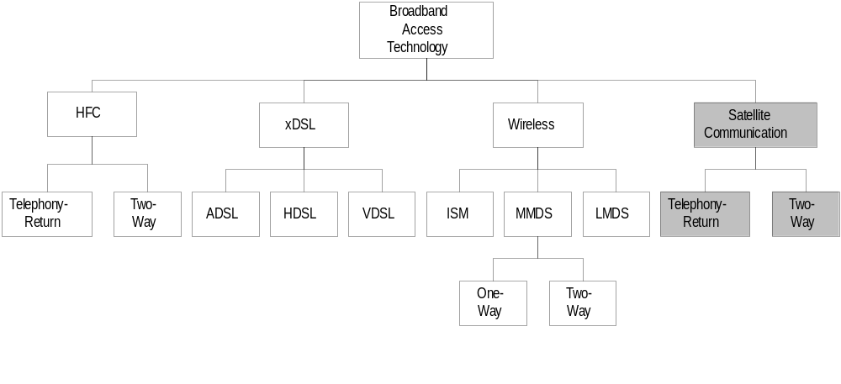
Chapter 10
Access Technologies
  Notes
Satellite communication
  Telephony return is one-way, downstream
  wireless, upstream telephone
  Two-way downstream and upstream wireless
Network Management: Principles and Practice
© Mani Subramanian 2000
10-8

Slide 9
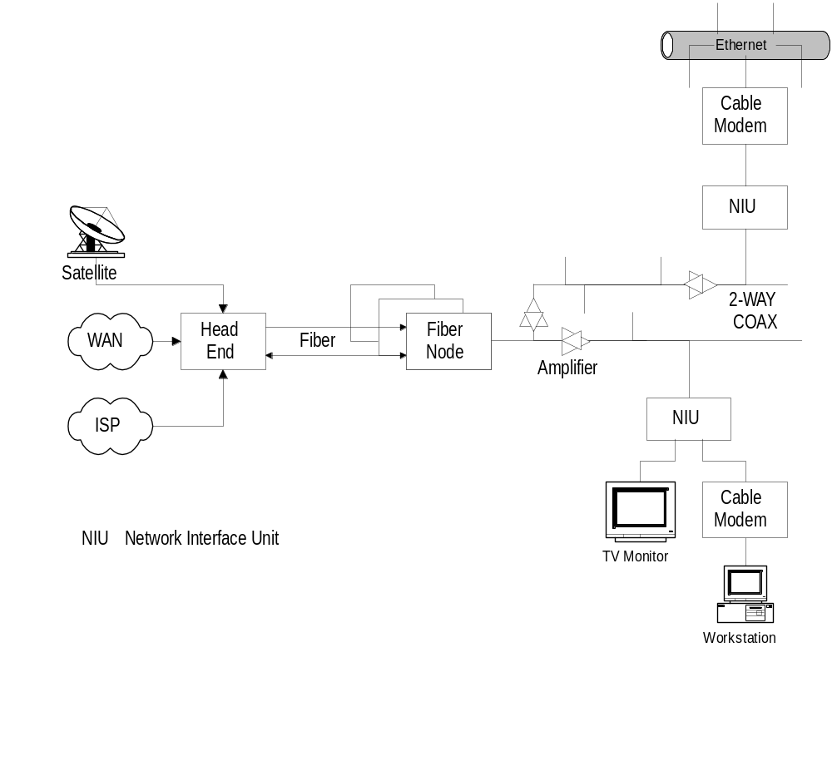
Chapter 10
HFC Network
  Notes
Fiber - 2 one-way transmission
Coaxial - 2-way transmission
2-way amplifiers
Fiber node: optical - RF conversion
Network Management: Principles and Practice
© Mani Subramanian 2000
10-9

Slide 10
Chapter 10
HFC Network
  Notes
Head end:
  Signals from multiple sources multiplexed
  Frequency conversion for local signal
Network interface device (NID) / unit (NIU)
Demarcation point between customer network and
service provider networks
Cable modem: RF Ethernet, analog telephony,
and video
Network Management: Principles and Practice
© Mani Subramanian 2000
10-10

Slide 11
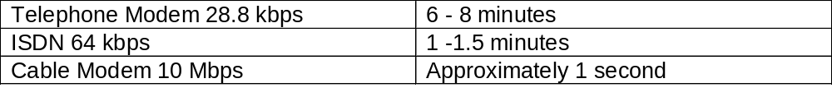
Chapter 10
Comparative Speeds
(Source: Cable Labs)
  Notes
Network Management: Principles and Practice
© Mani Subramanian 2000
10-11

Slide 12
Chapter 10
HFC Technology
Broadband LAN
Asymmetric bandwidth allocation for
2-way communication
RF spread-spectrum that carries multiple
signals over HFC
RF spectrum allocation to carry multimedia
services - voice, video and data
  Notes
Network Management: Principles and Practice
© Mani Subramanian 2000
10-12

Slide 13
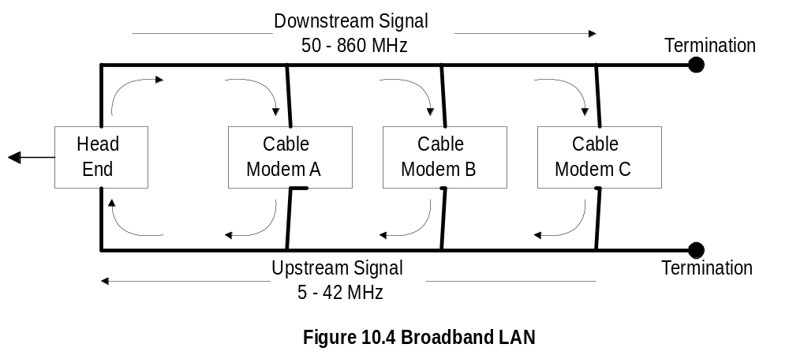
Chapter 10
Broadband LAN
  Notes
Network Management: Principles and Practice
© Mani Subramanian 2000
10-13

Slide 14
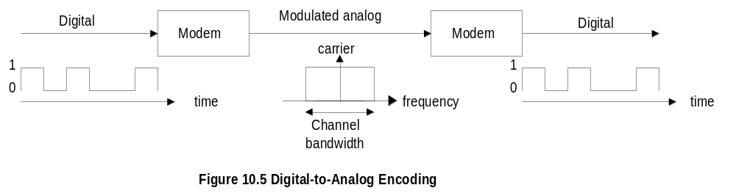
Chapter 10
Digital-to-Analog Encoding
bit rate
symbol rate
number of levels n = 2^{k}
bit rate = symbol rate x k
  Notes
Network Management: Principles and Practice
© Mani Subramanian 2000
10-14

Slide 15
Chapter 10
Modulation Schemes
Amplitude shift keying
Frequency shift keying
Phase shift keying
Quadrature phase shift keying
  Four levels ( 00, 01. 10, 11)
  Relatively insensitive to noise
  Used for low-band upstream
Quadrature amplitude modulation (not 4-levels)
  Combination of AM and PM
  16-QAM = 8 PM x 2 AM or 4 PM x 4 AM
  Used for higher-band downstream
  Notes
Network Management: Principles and Practice
© Mani Subramanian 2000
10-15

Slide 16
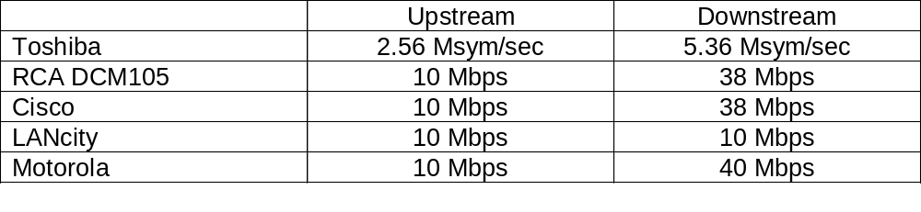
Chapter 10
Cable Modem
HFC uses tree topology
Downstream in broadcast mode
Upstream transmission by cable modem
coordinated by head end
Data over cable service specifications (DOCSIS)
for cable modem ensures interoperability
One-way cable modem uses telco-return
  Notes
Network Management: Principles and Practice
© Mani Subramanian 2000
10-16

Slide 17
Chapter 10
Functions of Cable Modem
Termination System
Equipment at the head end
All cable modems terminated on the head end
Gateway to the external network
Multiplexes and demultiplexes signals
Frequency converts upstream to downstream
signals
Can be designed either as a bridge or router
  Notes
Network Management: Principles and Practice
© Mani Subramanian 2000
10-17

Slide 18
Chapter 10
HFC Plant
Multiple fiber pairs run from head end to fiber node;
each pair carries 2 one-way signals
Head end converts all (telephony, digital video,
data, and analog video) signals to optical carrier
to transmit on the fiber
Houses are connected from fiber node via
coaxial cables
Coaxial cable are in tree topology and carries
2-way signal
Amplifiers on the coaxial cable have 2-way
amplifiers that amplify the signals in both directions
“Drop from coaxial cable to NID (also called NIU)
- called “Tap-to-TV” in CATV
  Notes
Network Management: Principles and Practice
© Mani Subramanian 2000
10-18

Slide 19
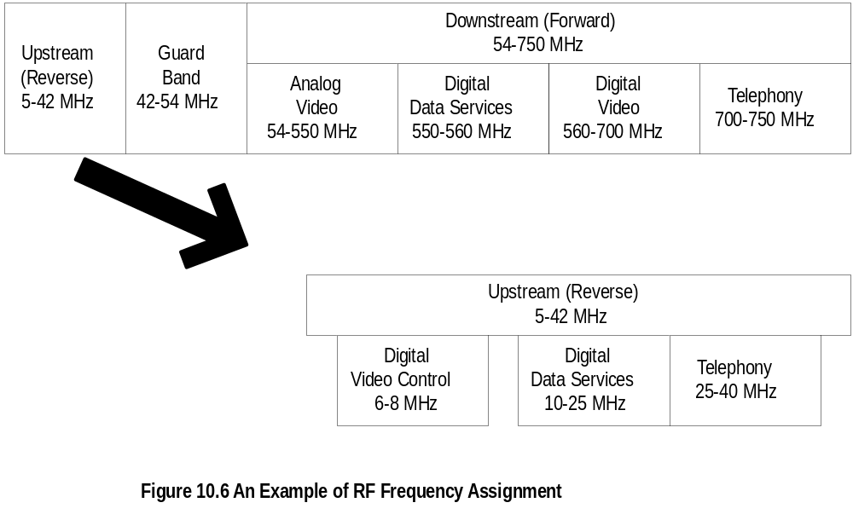
Chapter 10
RF Spectrum
  Notes
Network Management: Principles and Practice
© Mani Subramanian 2000
10-19

Slide 20
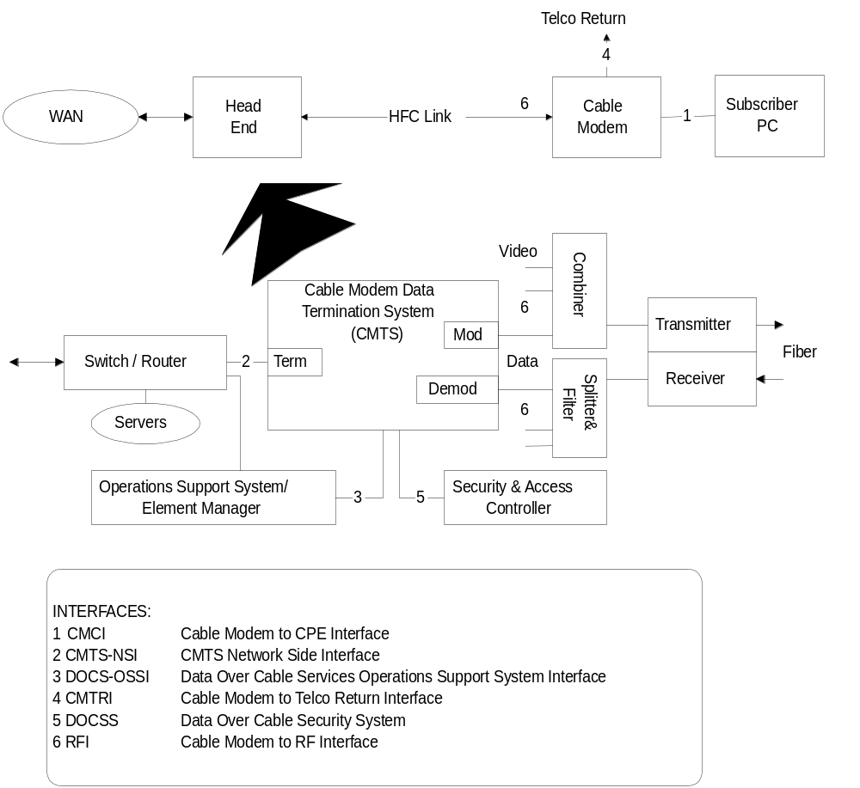
Chapter 10
DOCS Reference Architecture
Source: CableLabs
  Notes
The architecture shows two-way (HFC link)
and one-way (HFC link & telco return).
Network Management: Principles and Practice
© Mani Subramanian 2000
10-20

Slide 21
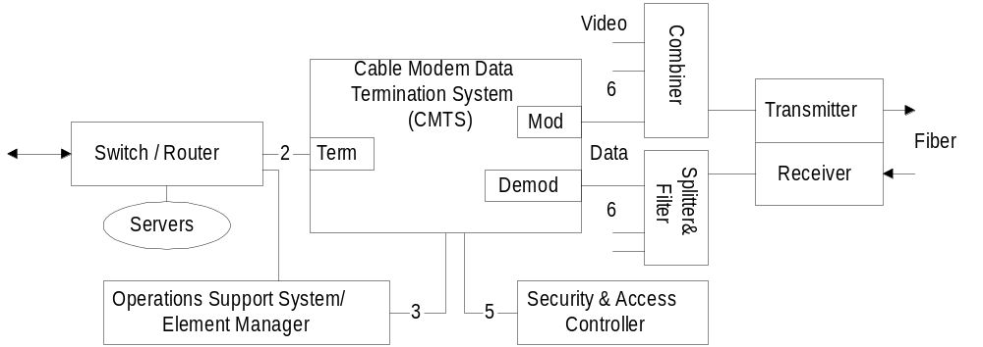
Chapter 10
CMTS Components
  Notes
Switch / router routes the traffic between cable
modems and to the external network. It interfaces
to CMTS via the terminator (term).
Modulator (mod) and demodulator (demod)
transform digital data from and to analog format.
Combiner and splitter and filter perform the
complimentary functions of mux’ing and demux’ing.
Transmitter converts the RF signals to optical carrier;
receiver down-converts the optical signal.
Servers handle the applications and databases.
Security is managed by the security and access
controller.
OSS and element manager perform network and
service management.
Network Management: Principles and Practice
© Mani Subramanian 2000
10-21

Slide 22
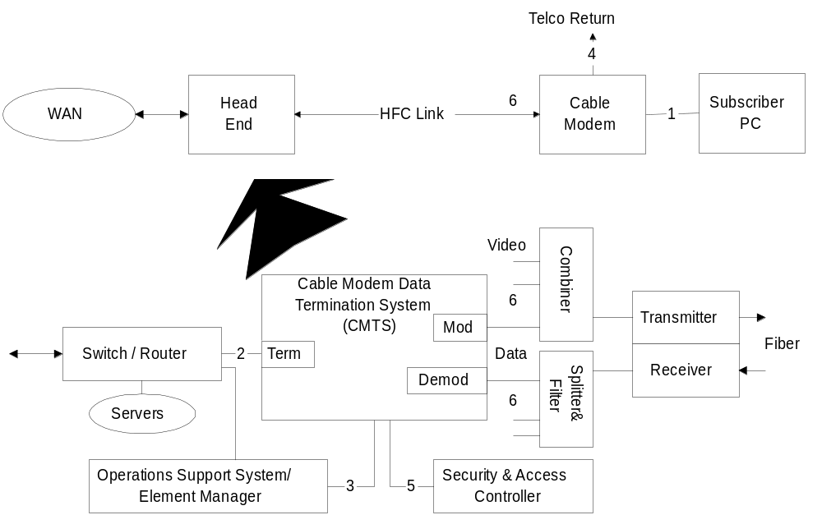
Chapter 10
DOCS Interfaces
  Notes
Three groups of interfaces:
  Data interfaces
    Cable modem to CPE (1)
    CMTS-NSI (2)
  Operations support systems and telco-return
    OSS (3)
    Telco-return (4)
  RF and security
    DOCS security system (5)
    RF interface (6)
Network Management: Principles and Practice
© Mani Subramanian 2000
10-22

Slide 23
Chapter 10
HFC Management:
Challenges
More complex than either computer network or
telecommunication network
Involves both physical and data layers
Multiple physical facilities
Legacy cable system
Multimedia service
RF spectrum management
Service and business management important
for MSOs and customer
Shared media impacts security and bandwidth
Security and privacy of home network
  Notes
Network Management: Principles and Practice
© Mani Subramanian 2000
10-23

Slide 24
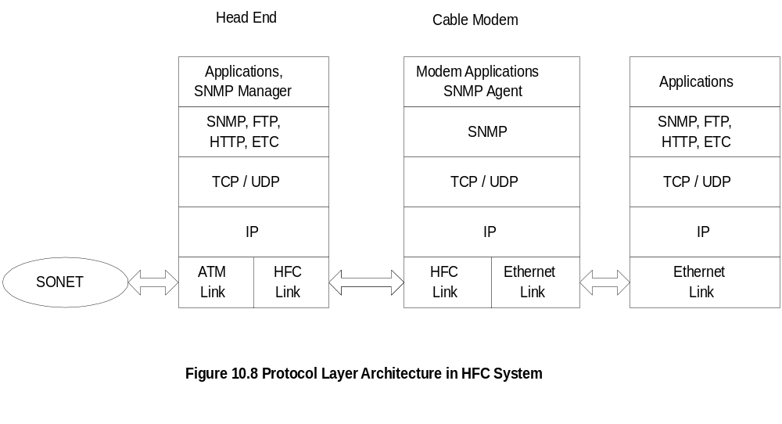

Chapter 10
HFC Protocol Architecture
  Notes
Head end has both NM applications and manager
Cable modems have SNMP agents
NMS can be regionalized; then, head ends could
behave as RMONs
Network Management: Principles and Practice
© Mani Subramanian 2000
10-24

Slide 25
Chapter 10
HFC / CM Management
Cable modem management
CMTS management
HFC link management
RF spectrum management
  Notes
Network Management: Principles and Practice
© Mani Subramanian 2000
10-25

Slide 26
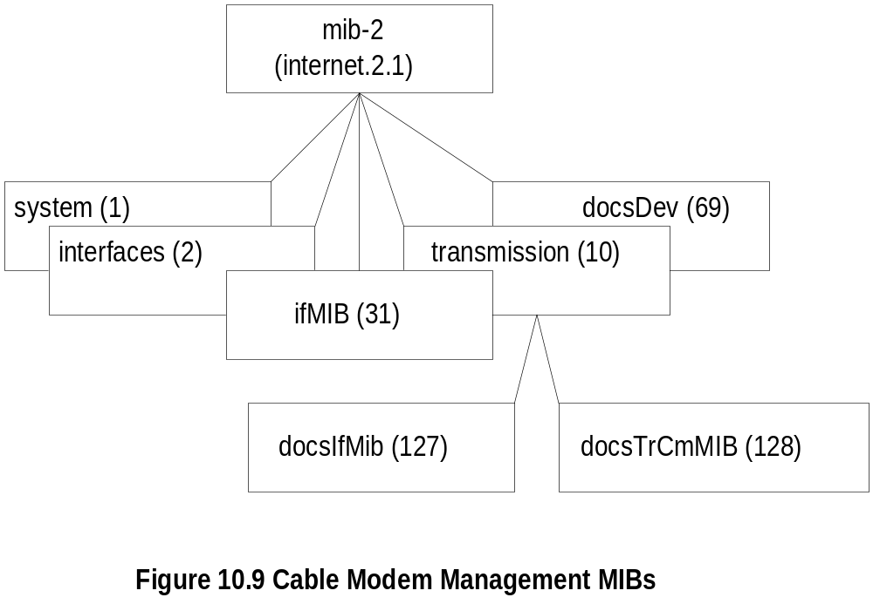
Chapter 10
CM Management MIBs
  Notes
Three categories of MIBs
  Standard MIBs:
    system, interfaces, ifMIB
  CM and CMTS interfaces
    docIfMIB .. RF Interfaces in CM and CMTS,
    base line privacy and QoS
    docsTrCmMIB .. telephony-return interface
  CM and CMTS objects
    docsDevMIB
Network Management: Principles and Practice
© Mani Subramanian 2000
10-26

Slide 27
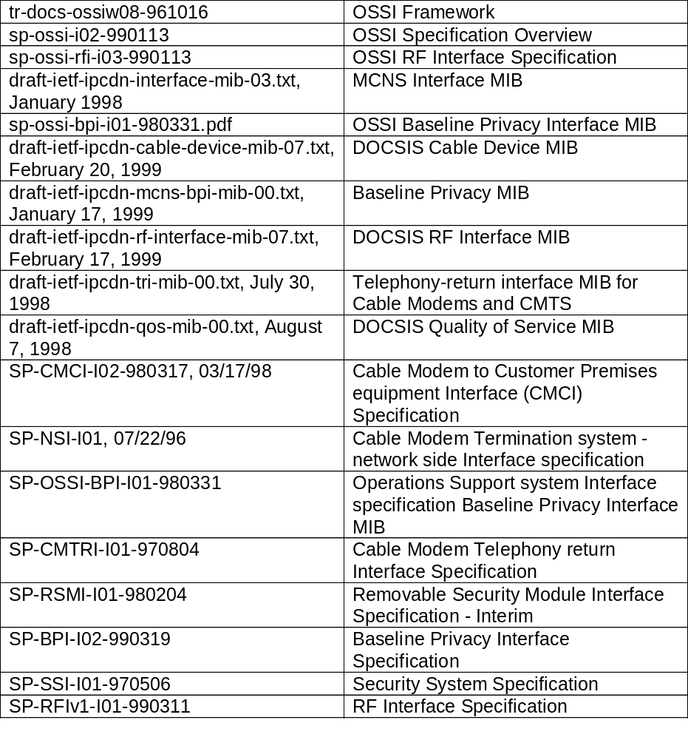
Chapter 10
DOCS Documentation
  Notes
Network Management: Principles and Practice
© Mani Subramanian 2000
10-27

Slide 28
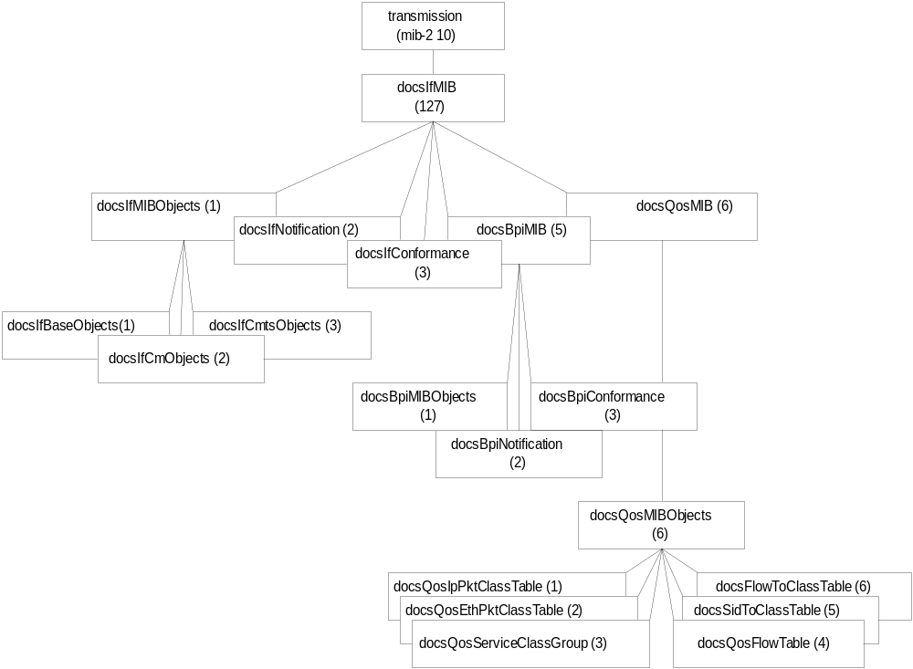
Chapter 10
DOCS Interface MIB
  Notes
Network Management: Principles and Practice
© Mani Subramanian 2000
10-28

Slide 29
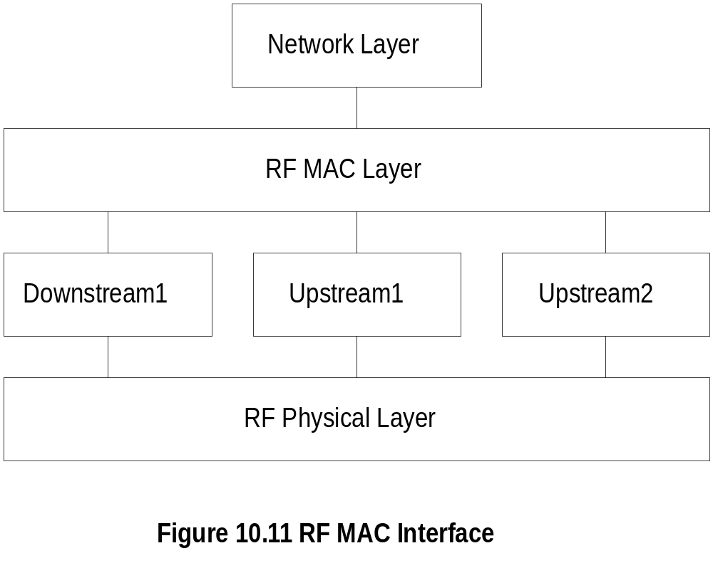
Chapter 10
RF MAC Interface
  Notes
Multiple RF channels upstream and downstream
Layered structure
Specified using RFC 1573 ifMIB
Network Management: Principles and Practice
© Mani Subramanian 2000
10-29

Slide 30
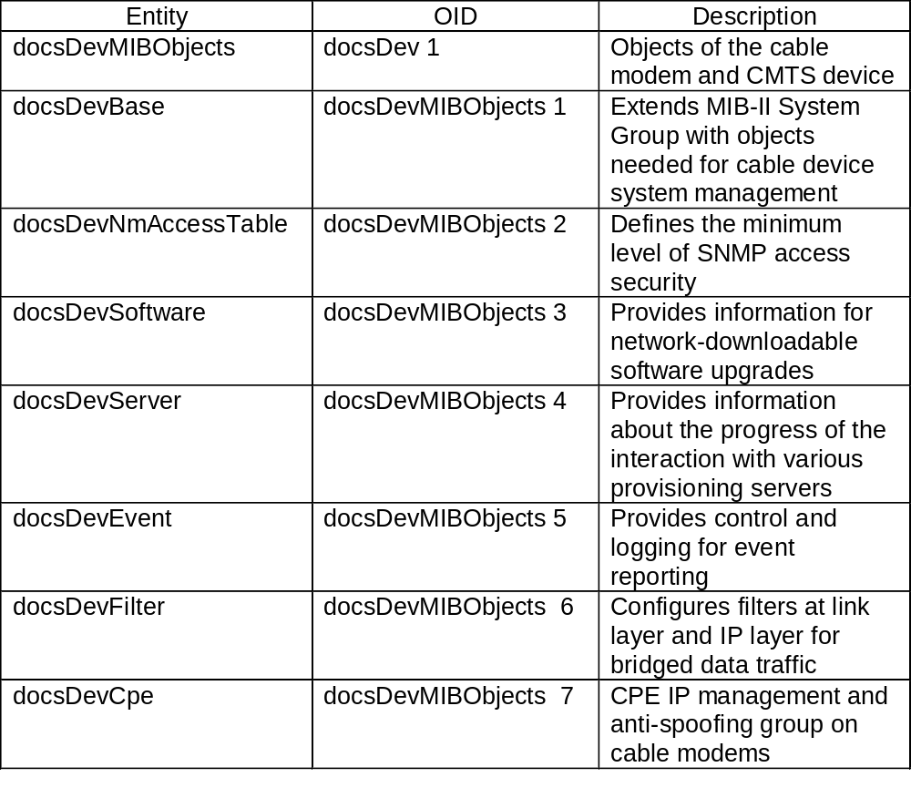
Chapter 10
DOCS Cable Device MIB
  Notes
Network Management: Principles and Practice
© Mani Subramanian 2000
10-30

Slide 31
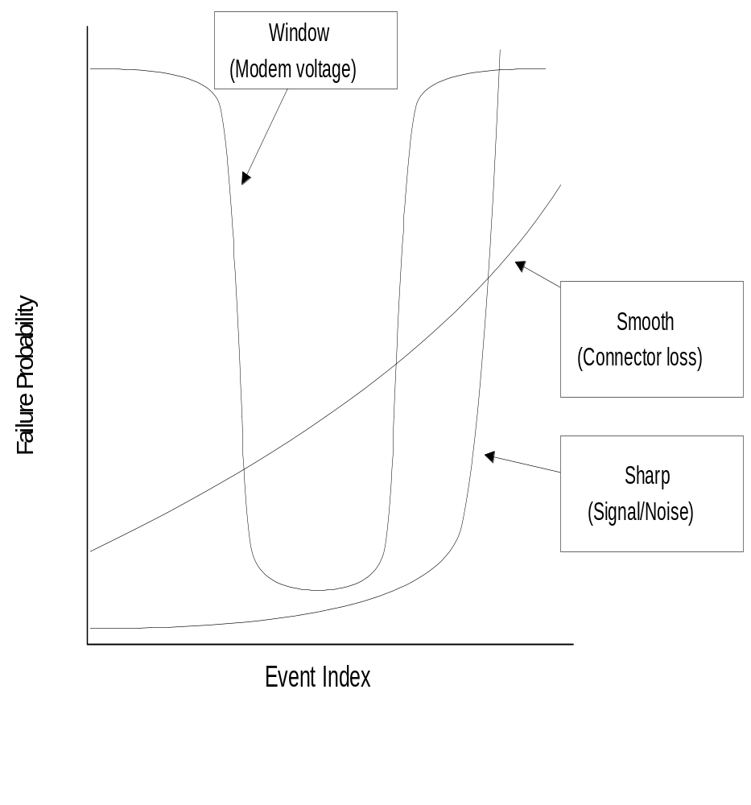
Chapter 10
HFC Failure Models
Network Management: Principles and Practice
© Mani Subramanian 2000
10-31

Slide 32
Chapter 10
Link & Spectrum Management
HFC Link Management
  Signal strength critical
  Requires continuous monitoring of amplifiers
  using transponders (CheetahNet)
  Legacy system requires proxy server
RF Spectrum Management
  Allocation of spectrum for services -
  upstream and downstream
  Frequency agility management
  Notes
Network Management: Principles and Practice
© Mani Subramanian 2000
10-32

Slide 33
Chapter 10
DSL Access Technology
Why is DSL attractive?
Shannon limit of data rate is 30,000 bps
(3-KHz, 30 dB S/N channel)
Digital transmission over loop (DSL) improves
data rate
  T1/DS1 (1.544Mbps) 18,000 feet
  T2/DS2 (6.312 Mbps) 12,000 feet
  Notes
Network Management: Principles and Practice
© Mani Subramanian 2000
10-33

Slide 34
Chapter 10
DSL Limitations
Loop conditions with no direct copper to the house
Loaded coils in loop (used to increase analog
distance) cannot carry digital signal
Modern subdivisions have fiber to the neighborhood
or curb with digital mux
Operating company inventory dated (administrative
issue)
  Notes
Network Management: Principles and Practice
© Mani Subramanian 2000
10-34

Slide 35
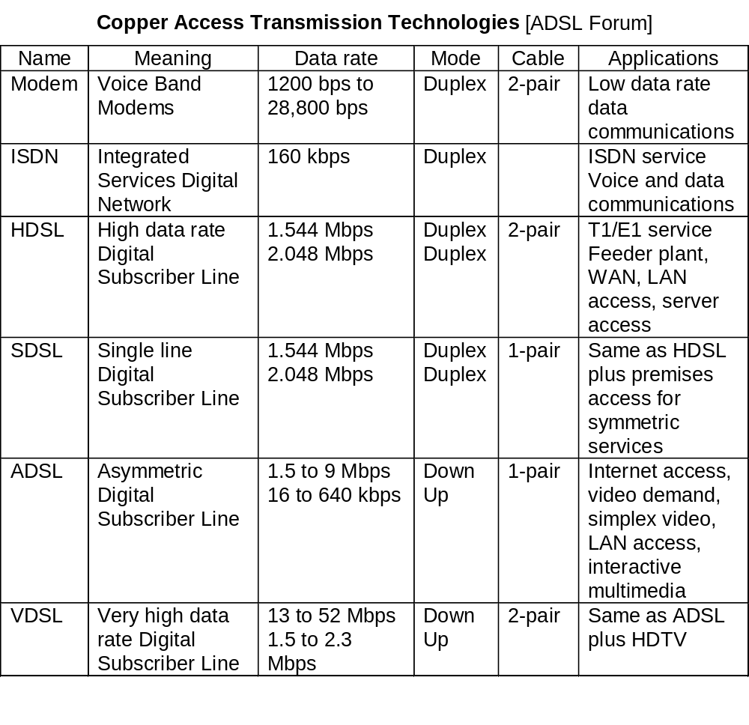
Chapter 10
xDSL Technologies
  Notes
Network Management: Principles and Practice
© Mani Subramanian 2000
10-35

Slide 36
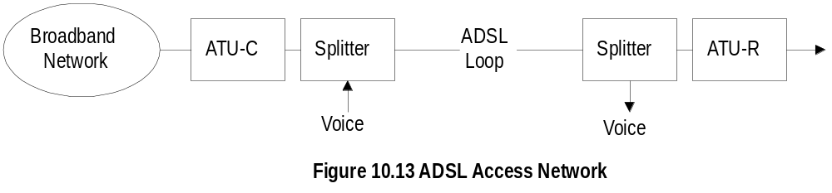
Chapter 10
ADSL Network
  Notes
ADSL .. Asymmetric Digital Subscriber Line
ATU-C ADSL transmission unit - central office
ATU-C ADSL transmission unit - remote/residence
Splitter separates voice and data
Network Management: Principles and Practice
© Mani Subramanian 2000
10-36

Slide 37
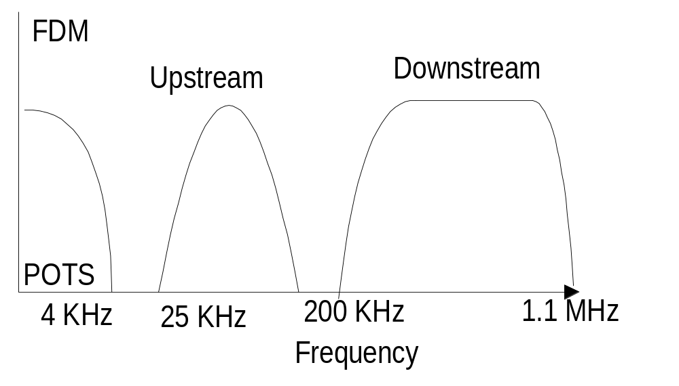
Chapter 10
ADSL Spectrum Allocation
with Guard Band
  Notes
POTS .. Plain old telephone service
Network Management: Principles and Practice
© Mani Subramanian 2000
10-37

Slide 38
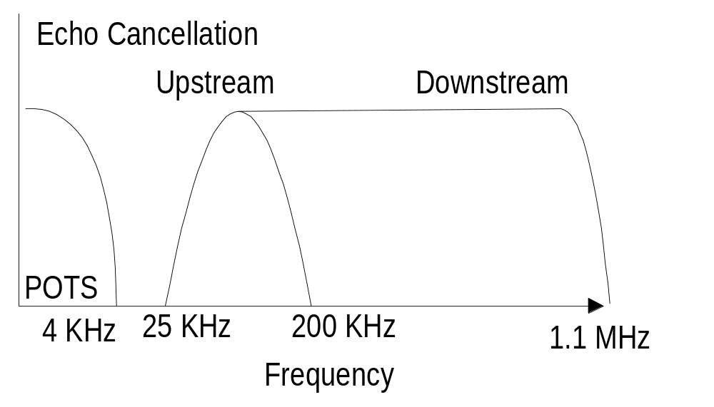
Chapter 10
ADSL Spectrum Allocation
with Echo Cancellation
  Notes
Echo cancellation separates upstream and
downstream signals
Increases (low-frequency) upstream bandwidth
Network Management: Principles and Practice
© Mani Subramanian 2000
10-38

Slide 39
Chapter 10
Modulation Schemes
Carrierless amplitude phase (CAP) modulation
Discrete multiTone modulation (DMT): 4kHz tones
Both CAP and DMT are QAM-based
DMT outperforms CAP
  4-to-1 downstream throughput
  10-to-1 upstream throughput
  Rate adaptive
  On-going active monitoring
  Maximum loop variation coverage
  Standard and hence interoperability
  Notes
Network Management: Principles and Practice
© Mani Subramanian 2000
10-39

Slide 40
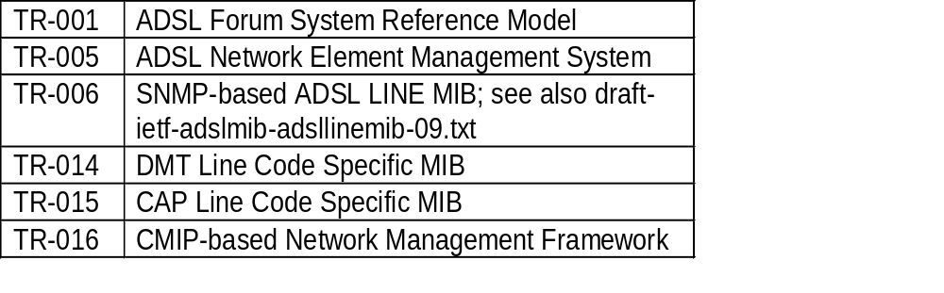
Chapter 10
ADSL Forum
ADSL Forum is an industry consortium to
  achieve interoperability
  accelerate implementation
  address end-to-end system operation
  security
  management
Physical layer standard T1-413 (ANSI)
  Notes
Network Management: Principles and Practice
© Mani Subramanian 2000
10-40

Slide 41

Chapter 10
VDSL Network
  Notes
Used in FTTN configuration
Asymmetric band allocation (similar to ADSL)
Fiber carries multiple channels to ONU
Channels demultiplexed at ONU and carried to
customer premises on multiple twisted pairs
Shorter distance of twisted pairs permission of
higher data rate - 55.2 Mbps downstream and
2.3 Mbps upstream
Network Management: Principles and Practice
© Mani Subramanian 2000
10-41

Slide 42
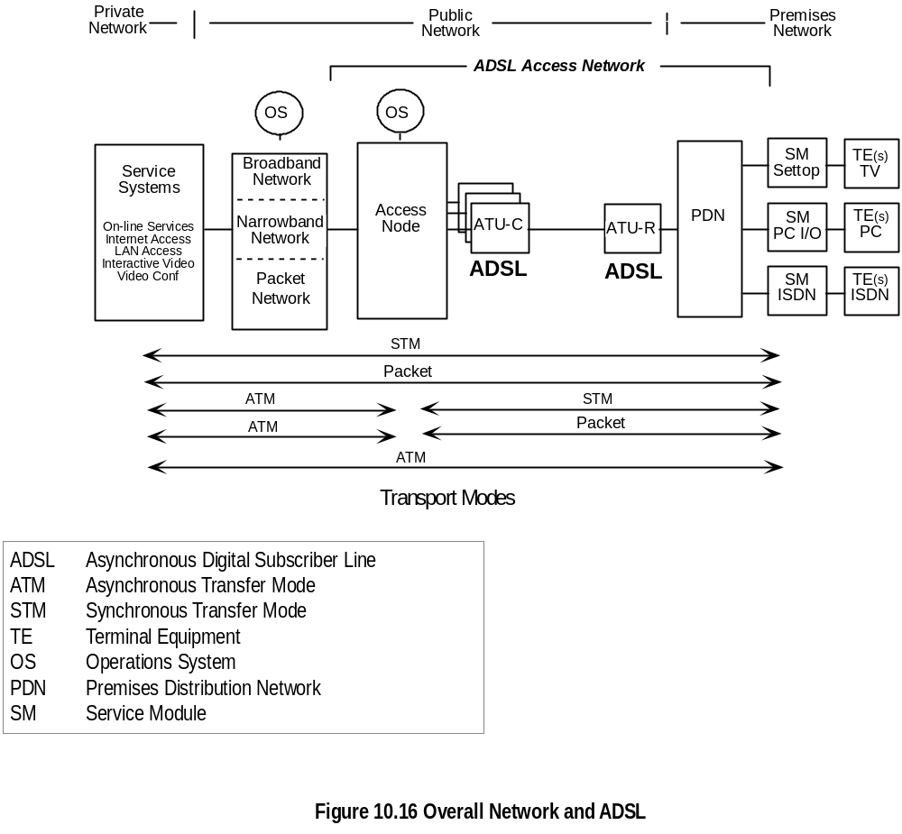
Chapter 10
ADSL Network
  Notes
Network Management: Principles and Practice
© Mani Subramanian 2000
10-42

Slide 43
Chapter 10
Transport Modes
Synchronous transport mode (STM)
  Bit synchronous transmission ( T1/E1)
End-to-end packet mode
  Used for SOHO (IP packets)
ATM / STM
  ATM WAN (Public network) and
  STM access network
ATM / Packet
  ATM WAN and packet access network (IP)
End-to-end ATM
  Notes
Network Management: Principles and Practice
© Mani Subramanian 2000
10-43

Slide 44
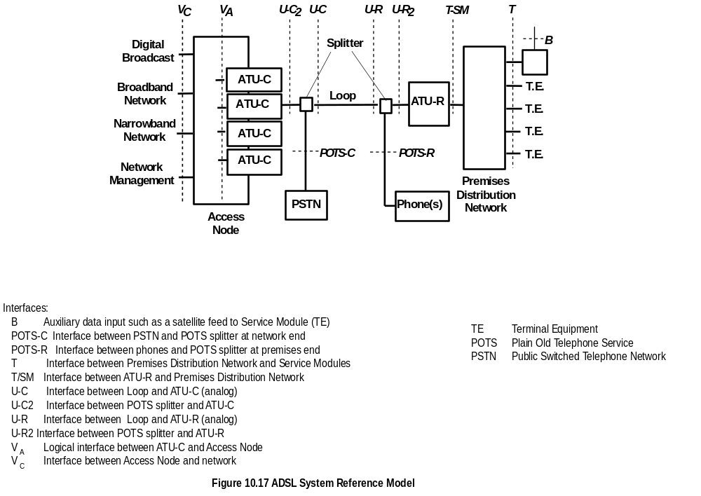
Chapter 10
ADSL System Reference Model
  Notes
(ADSL Forum)
Network Management: Principles and Practice
© Mani Subramanian 2000
10-44

Slide 45
Chapter 10
Interfaces
An interface can have multiple physical connections
V interface
  V_{C} interface between access node and
  external network and interfaces
U interfaces - off the splitters; Will be eliminated with
ADSL-Lite
POTS interfaces - low pass filter interfaces for POTS
T and B are customer premises network interfaces
  T between PDN and service modules
  B auxiliary data input (e.g., satellite feed)
  Notes
Network Management: Principles and Practice
© Mani Subramanian 2000
10-45

Slide 46
Chapter 10
ADSL Channeling Schemes
ATU-C
ATU-R
Downstream bearer channels
Duplex bearer channels
ATU-C
ATU-R
Fast channel
Interleaved channel
  Notes
Transport bearer channels
  Seven AS downstream channels
  - multiples (1-, 2-, 3- or 4-) T1 rate of 1.536 Mbps
  Three LS duplex channels
  - 160. 384, and 576 Kbps
Buffering scheme
  Fast channel: uses fast buffers for real-time data
  Interleaved channel: used for non-real-time data
  Both fast and interleaved channels carried on the
  same physical channel
Network Management: Principles and Practice
© Mani Subramanian 2000
10-46

Slide 47
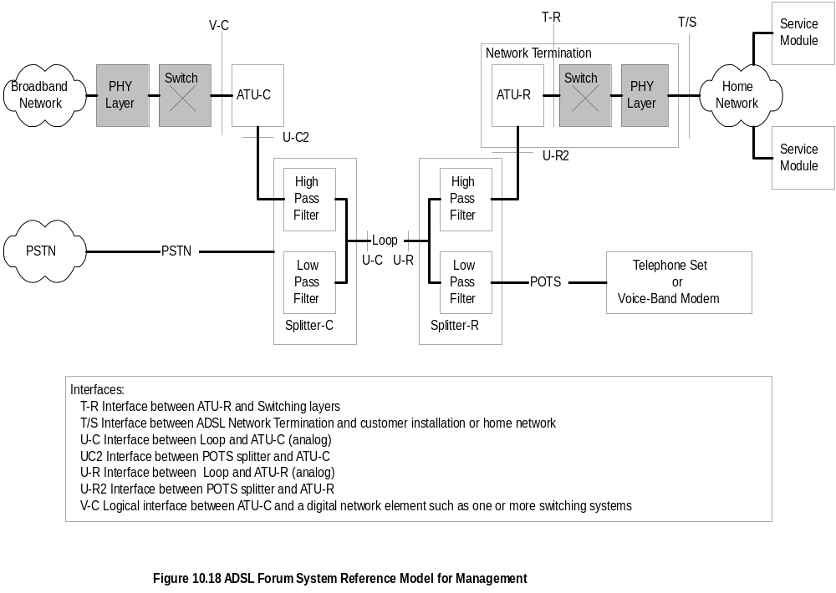
Chapter 10
Management Reference Model
  Notes
Network Management: Principles and Practice
© Mani Subramanian 2000
10-47

Slide 48
Chapter 10
Management Elements
Management of elements done across V-interface:
  Management communications protocol
  across V-interface
  Management communications protocol
  across U-interfaces
  Parameters and operations across ATU-C
  Parameters and operations across ATU-R
  ATU-R side of the T interface
  Notes
Note addition of physical layer and switching in the
management architecture representation
Management of physical layer involves:
  Physical channel
  Fast channel
  Interleaved channel
Management of type of line encoding
  DMT
  CAP
Network Management: Principles and Practice
© Mani Subramanian 2000
10-48

Slide 49
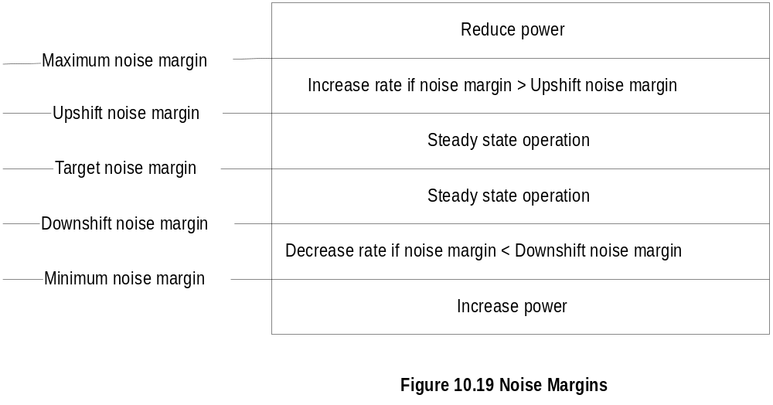
Chapter 10
Signal Power and Data Rate Mgmt
  Notes
Five levels of noise margin
Signal power controlled by noise margin
Data rate: Increase or decrease based on
threshold margins
Data rate adaptation modes: Manual (1),
automatic at start-up (2), and dynamic (3)
Network Management: Principles and Practice
© Mani Subramanian 2000
10-49

Slide 50
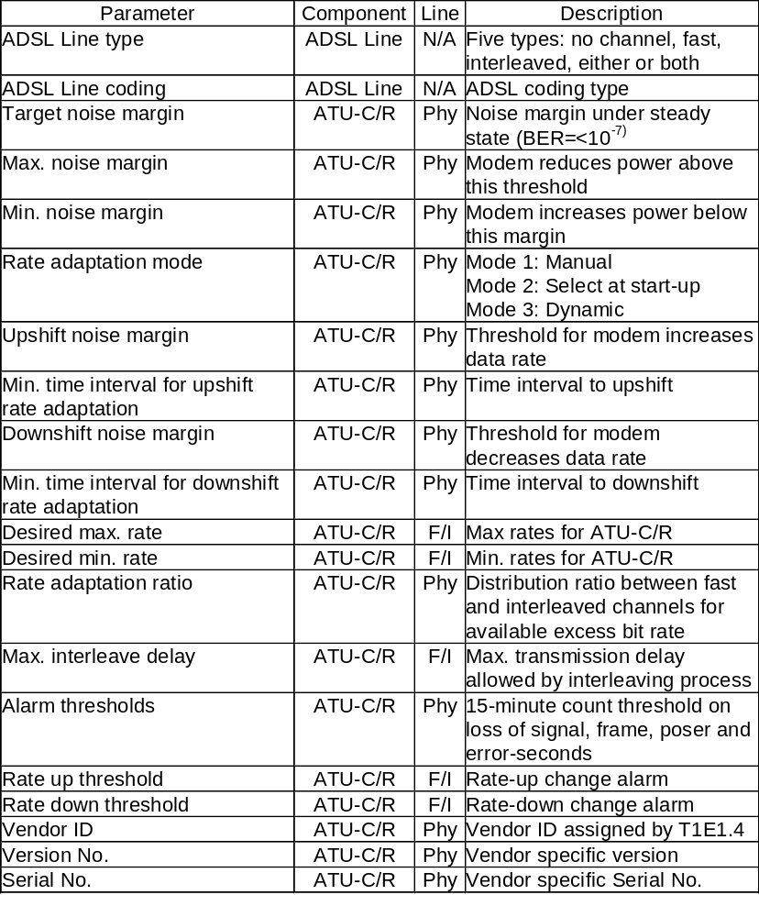
Chapter 10
Configuration Mgmt Parameters
Network Management: Principles and Practice
© Mani Subramanian 2000
10-50

Slide 51
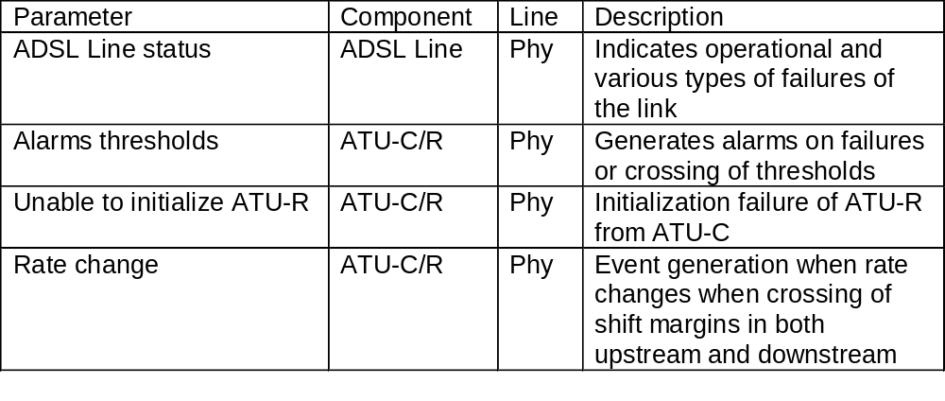
Chapter 10
Fault Management
  Notes
Failure indication of physical channel by NMS
Failure indication of logical channels
Failure indication of ATU-C/R
Self-test of ATU-C/R as per T1.413
Noise margin threshold alarms
Rate change due to noise margin
Network Management: Principles and Practice
© Mani Subramanian 2000
10-51

Slide 52
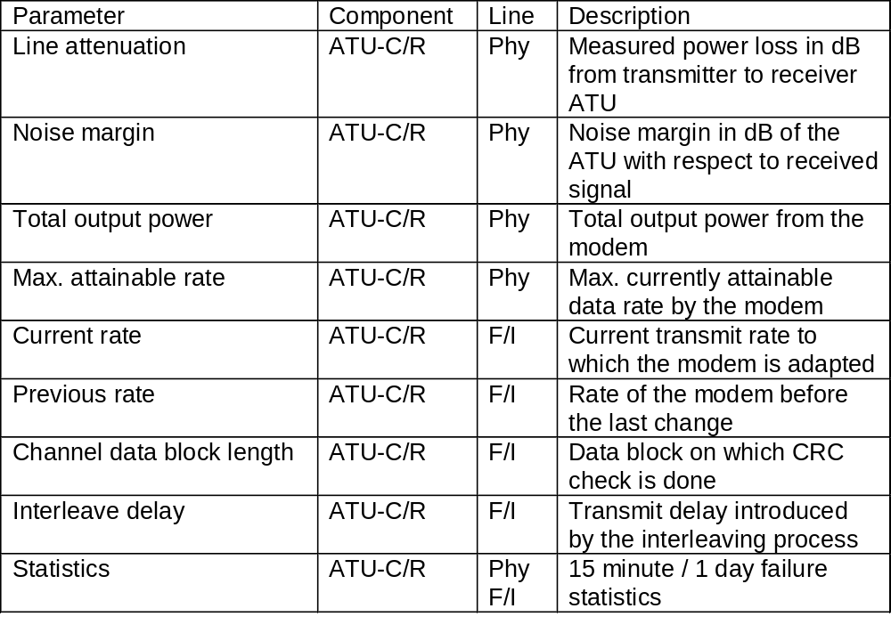
Chapter 10
Performance Management
  Notes
Line attenuation
Noise margin
Output power
Data rate
Data integrity check
Interleave channel delay
Error statistics
Network Management: Principles and Practice
© Mani Subramanian 2000
10-52

Slide 53
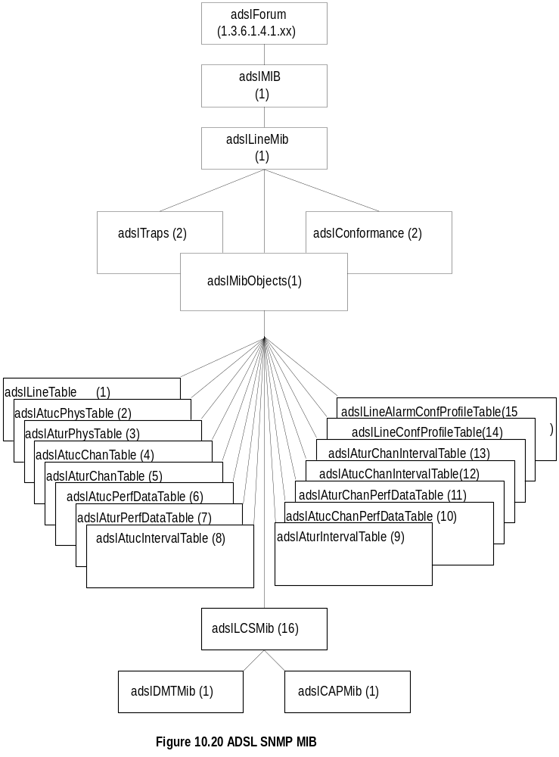
Chapter 10
ADSL SNMP MIB
Network Management: Principles and Practice
© Mani Subramanian 2000
10-53

Slide 54
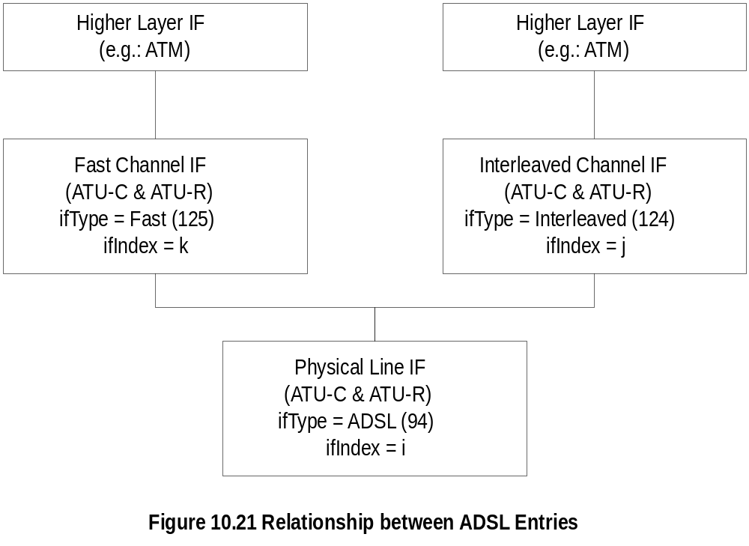
Chapter 10
Proposed IF Types
  Notes
Sub-layers handled by ifMIB
ifStackTable {ifMib.ifMIBObjects 2} (RFC 1573)
Propose ifTypes
adslPhysIf ::= {transmission 94}
adslInterIf ::= {transmission 124}
adslFastIf ::= {transmission 125}
Network Management: Principles and Practice
© Mani Subramanian 2000
10-54

Slide 55
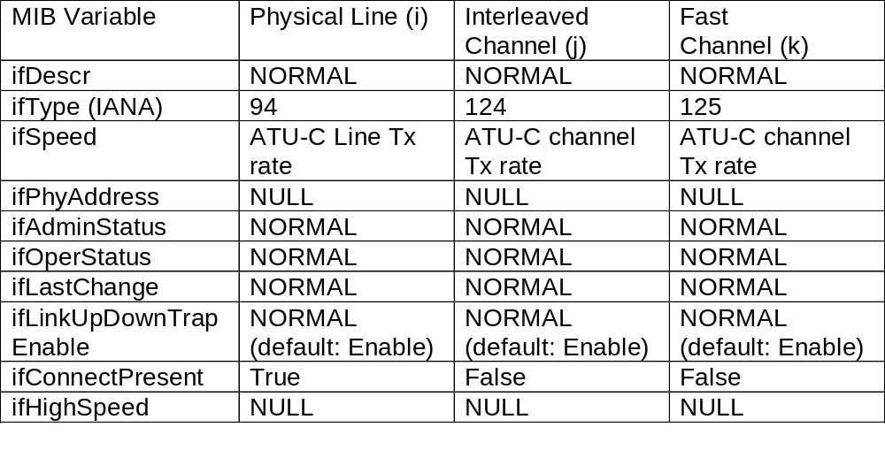
Chapter 10
ADSL Interfaces Table
  Notes
Network Management: Principles and Practice
© Mani Subramanian 2000
10-55

Slide 56
Chapter 10
ADSL Profiles Management
Configuration profile
Performance profile
Alarm profile
Traps
  Generic
  Loss of frame
  Loss of signal
  Loss of power
  Error-second threshold
  Data rate change
  Loss of link
  ATU-C initialization failure
  Notes
Network Management: Principles and Practice
© Mani Subramanian 2000
10-56

Slide 57
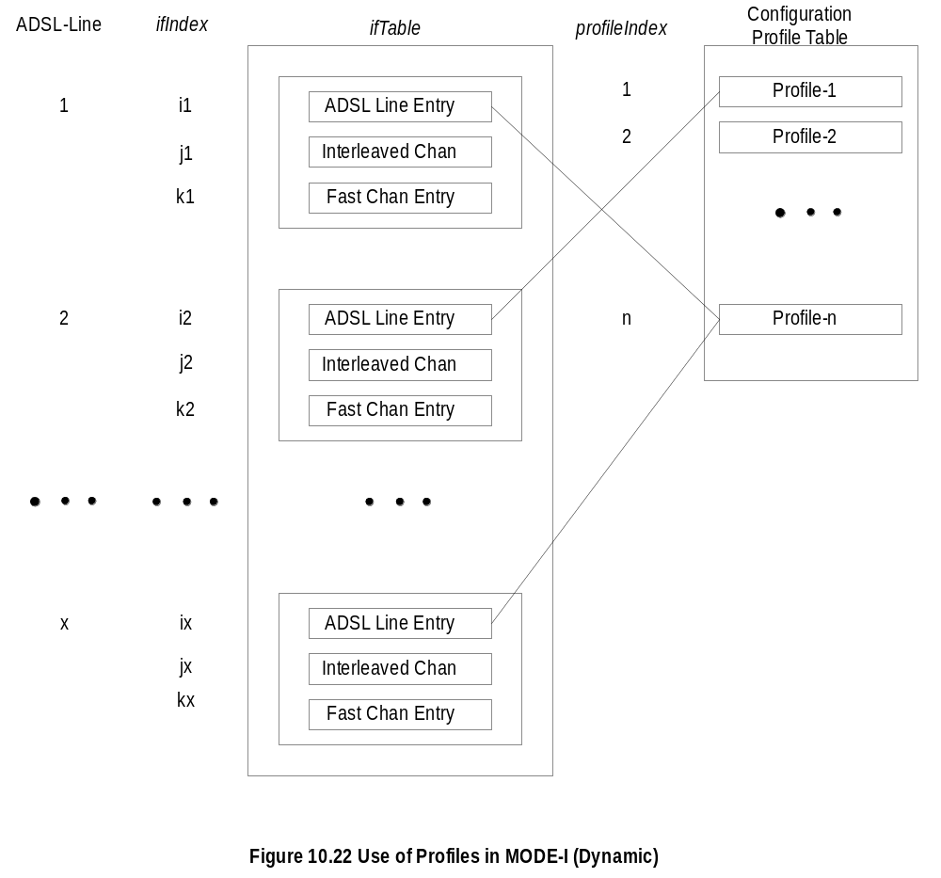
Chapter 10
Configuration Profile:
Mode I - Dynamic
Network Management: Principles and Practice
© Mani Subramanian 2000
10-57

Slide 58
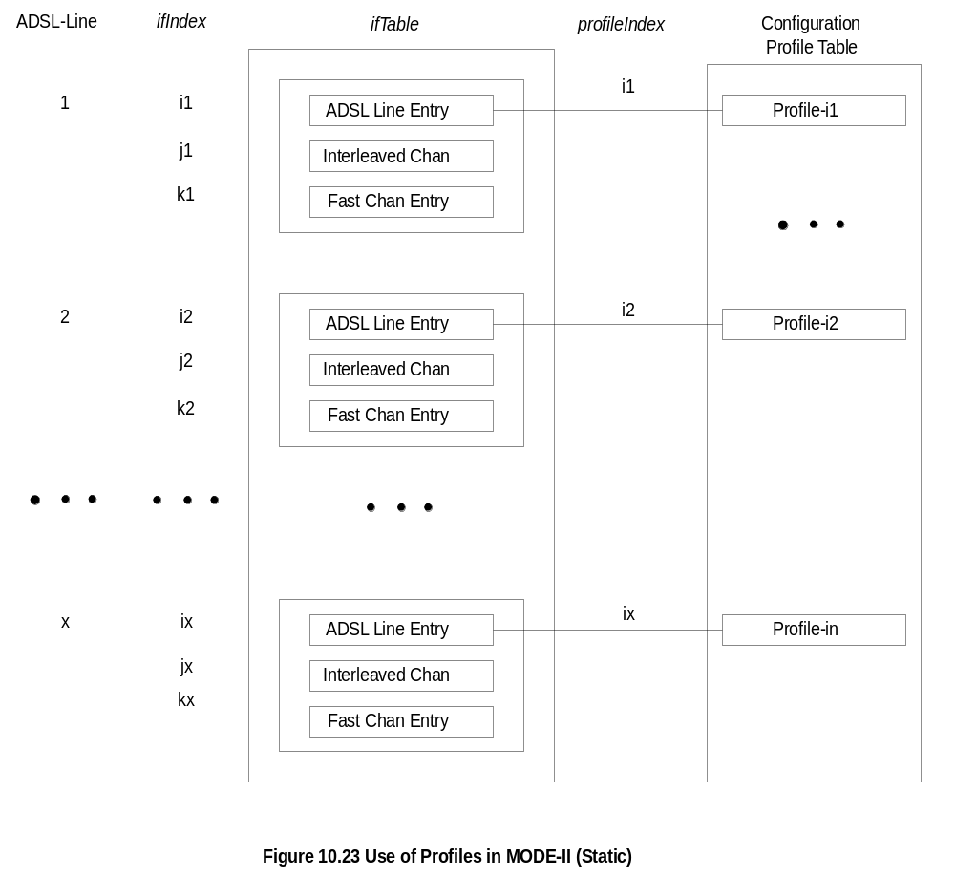
Chapter 10
Configuration Profile:
Mode II - Static
Network Management: Principles and Practice
© Mani Subramanian 2000
10-58

